Slide 1
Contributory Pension Scheme
Members’ Meeting
2 March 2020

Slide 2
Agenda
Chairman’s Introductory Remarks Howard Jacobs
University Pension Arrangements Sue Curryer
Pensions Basics Sue Curryer
SEI master trust Toby Cross
HR update Sam Murphy
Q & A All

Slide 3
Agenda
  Welcome
  Live streaming
  Universities Superannuation Scheme
  Feedback on annual members’ meeting

Slide 4
University Pension Arrangements - Overview
University
Assistant Staff
Cambridge University Assistants’ Contributory Pension Scheme
Cambridge University Assistants’ Defined Contribution Pension Scheme
Academic and Academic Related Staff
Universities Superannuation Scheme
NHS
(clinical staff only)

Slide 5
University Pension Arrangements
- Joined after 31 December 2012
Hybrid pension
arrangement
Cambridge University Assistants’ Contributory Pension Scheme (CUACPS)
Cambridge University Assistants’ Defined Contribution Pension Scheme (CUADCPS)

Slide 6
Pensions Basics
What is a pension?
Do I really need a pension?
What’s so good about my University pension?
What’s the difference between defined benefit and defined contribution pensions?
The importance of your pension throughout life

Slide 7
Pensions Basics
What is a pension?
A pension is designed to give you an income when you finish work. In simple terms, it is a way of saving for the future.

Slide 8
Pensions Basics
Do I really need a pension?
Reasons people do not think pensions are important.
I am too young to think about it.
Pensions are too expensive.
Pensions are boring and difficult to understand.
I can’t access my money until I’m older.
My pension will not give me enough to live on anyway.
I would be better off investing in property or saving into an ISA.

Slide 9
Pensions Basics
OK – how much money do you think you will need to live comfortably in retirement?
Have you ever thought about the amount you would need to live on and where this money is going to come from?
Do you think the state pension is enough? Do you know how much the state pension is for 2020/2021?
£9,110.40 per annum
£175.20 per week
Could you live on that?
These figures are also based on an individual paying the full 30 years National Insurance contributions.

Slide 10
Pensions Basics
How long to you think the average person will live?
Average UK Life Expectancy for Women?
83
Average UK Life Expectancy for Men?
79
If you’re 52, 50% of you are expected to live to 91
If you’re 32, 50% of you are expected to live to 97
Saving for later life is important.

Slide 11
Pensions Basics
So what’s so good about my University pension?
It will provide an income for the rest of your life when you stop working
Your pension will be based on your earnings and comes with guarantees
You receive tax relief on your contributions at your highest marginal rate
The University pays much more towards your pension than you

Slide 12
Pensions Basics
So what’s so good about my University pension?
You could receive an ill-health pension before retirement should you need to stop work due to illness or injury
It provides death benefits, including a possible lump sum and pension for your spouse / civil partner / partner
Your pension is protected from the effects of inflation

Slide 13
Pensions Basics
What is the difference between defined benefit and defined contribution pensions?
Defined benefit (DB) pensions are based on your earnings. A percentage of your earnings goes towards your pension each month. These monthly pension amounts are added together to give your pension. This type of pension gives you a guarantee as once your pension is earned, it cannot be taken away and your pension will continue to build up at the same rate while you are working.
Defined contribution (DC) pensions work like a savings account. You pay in an amount each month, into your own account or pension pot and your pension is based on the value of your pot when you retire. Your pot will also be invested in funds which means the value of your pot will also depend on how the funds perform. This means there is no guarantee on the pension you will receive at retirement. You will learn more about DC pensions from Toby shortly.

Slide 14
Pensions Basics
You decide you would like to pay more into your pension
No problem. You can pay more into your pension by paying Additional Voluntary Contributions (AVCs).
You leave the employment of the University
If you have worked at the University for more than two years, you will be entitled to what is known as a deferred pension, which simply put means you have a pension that is calculated and ‘frozen’ as at your date of leaving. The pension will still be payable to you at retirement and you could also consider a transfer to another pension scheme, such as one with your new employer. If you work for the University for less than 2 years there are different rules depending on which scheme you belong to. You may need to transfer your benefits elsewhere.
You go through a difficult patch financially
Although not recommended, you can opt out of your pension at anytime. You must remember you will lose pension and your death benefit cover by doing so. You can opt back in at any time.

Slide 15
Pensions Basics
You get divorced
Don’t be surprised if you need to obtain some information regarding your pension. We have a special pack that is sent to members for matrimonial purposes.
You decide it’s time to put your feet up
Hurray! It’s time to benefit from your pension. Let HR know and arrangements will be put in place to bring your pension into payment.
Then after many happy years in retirement, we hear the sad news of your passing.
Your pension is stopped and we pay any lump sum benefits and a spouse’s pension.

Slide 16
Pensions Basics
Other matters to consider.
Salary sacrifice
You give up part of your salary each month, equal to the amount of your pension contributions, and this is paid by the University to your pension. As a result, your salary is lower and both you and the University pay less in National Insurance Contributions.
Pension Scams
You may have seen the advert with the guy on a jet ski. Pension scams are ever increasing and everyone with a pension needs to be aware inscrutable individuals are out there trying to get their hands on pension funds. If you receive a cold call, email, text or any enquiry you were not expecting regarding your pension, be very suspicious.
Please refer to: https://www.pensionsadvisoryservice.org.uk/pension-problems/making-a-complaint/common-concerns/pension-scams

Slide 17
Pensions Basics
How to contact the Pensions office / find out more about my University pension.
The Pensions office is based at Greenwich House and our email address is pensionsonline@admin.cam.ac.uk. Alternatively, you can ring us on (01223) 332214.
If you would like to speak to someone face-to-face regarding your pension, please contact us and make an appointment. This ensures there is someone available to speak with you and we can do any necessary preparatory work.
We also have extensive information on our website.
https://www.pensions.admin.cam.ac.uk

Slide 18
Presentation to
Members of the Cambridge University Assistants Contributory Pension Scheme (CUACPS)
            Toby Cross
            March 2020

Slide 19



Agenda
1
How the pension scheme works
2
Taking control
3
Questions

Slide 20
How the DC pension scheme works

Slide 21
Roles and Responsibilities
University of Cambridge
CUACPS Section of the SEI Master Trust
Trustees who always act in your best interests
Investment
Administration
Communications

Slide 22


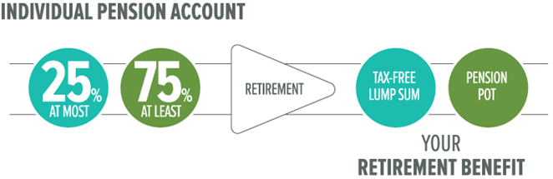

Contributions
Your employer
Contributes
5%…
…and can save too
You receive tax relief on up to 100% of pensionable pay, subject to the Annual Allowance (£40,000 in 2019/2020)

Slide 23
Contribution Example
You and your employer make contributions as a % of pensionable salary
You get tax relief on your contributions
Reduction in take home pay
£200 Total
£100
from
you
-£80
Pensionable Salary of £24,000 pa / £1,200 pm
The University pays 5% and employee saves 5% of Pensionable Salary into their account
Total of 10% Pensionable Salary = £200 pm
£20 Tax relief
£100
from UofC

Slide 24
Your Investment Options
Default Investment Option
Do it for me
Alternative Investment Option
Make one decision
Self Select Funds
Do it yourself

Slide 25
Default Investment Option (Do it for me)
Initially invested in growth assets which offer a potential for higher return but also have a higher risk
Automatically switched into lower-risk, lower-return funds as you get closer to retirement
Stay in this strategy or switch at any time
Total annual management charge is 0.50%
Your retirement age assumed to be 65.

Slide 26
Alternative Investment Option (Make one decision)
Alternative Lifestyle Strategy is a lower risk version of the Default Investment Option
Initially invested in growth assets and bonds
Automatically switched into lower-risk, lower-return funds as you get closer to retirement
Stay in this strategy or switch at any time
Total annual management charge is 0.50%
Your retirement age assumed to be 65.

Slide 27
Choose your own funds (Do it yourself)
Self Select Funds | Risk Level | Total Expense Ratio (% p.a)
SEI Aggressive Fund¹ | Aggressive | 0.88%
SEI Growth Fund¹ | Moderate-Aggressive | 0.83%
SEI Core Fund¹ | Moderate | 0.78%
SEI Moderate Fund¹ | Conservative-Moderate | 0.73%
SEI Defensive Fund¹ | Conservative | 0.68%
SEI UK Core Fixed Interest Fund¹ | Conservative-Moderate | 0.50%
SSgA Sterling Liquidity Fund² | Conservative | 0.10%
SSgA Global Equity 50:50 Index Fund² | Aggressive | 0.12%
¹ Actively managed ‘Manager of Manager’ Fund; ² Passively managed Index Fund
Please note the SSgA Funds also have a bid/offer spread.

Slide 28
Taking Control

Slide 29
How do I make changes?
You can make changes via the member website or by contacting the SEI administration team directly
SEI Master Trust Pension Scheme Administration
    Email: seic@capita.co.uk
    Call: 0800 0113540 Monday to Friday from 9am to 5pm
    Website: www.hartlinkonline.co.uk/sei

Slide 30





What can I do myself online?
Contributions
Investments
Documentation
Nominations
Planning Tools

Slide 31
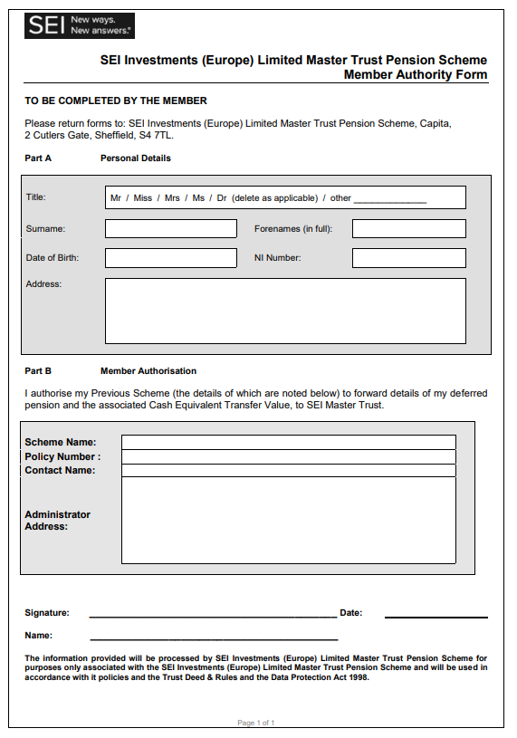
What if I have other pensions?
You can transfer other pension plans into the SEI Master Trust;
If you wish to transfer, you’ll need to complete and return the authority form which can be found online;
Alternatively, you can speak to a member of the administration team who can discuss this with you.
The Trustee recommends that you take financial advice when considering transfers.

Slide 32
What happens if I leave CUACPS?
We will write to explain your options
Recommend you update your contact information
Contributions stop, but you can still transfer pensions in
Stay in the Pension Plan and still take benefits from 55
or
Transfer your pension account to another pension (at any time)
Take financial advice and beware of scams if considering a transfer
Visit FCA site https://www.fca.org.uk/scamsmart for more information.

Slide 33
What if I should die before retirement?
Value of your fund is payable as a lump sum
Trustee will consider you wishes before deciding where benefits should be paid
So please tell us who you would like the benefits to be paid to
And let us know if your circumstances change.

Slide 34
When can I take my pension?
Access some (or all) of your account from age 55 onwards
25% of your account is tax-free and the other 75% taxable
Take regular income, lump sum(s) or ‘income for life’
Trustee recommends guidance and advice first, even if fees payable
Trustee appointed a Retirement Adviser, or you can obviously use your own
Full details on the website and we’ll send them as you approach retirement.

Slide 35
Any Questions?

Slide 36
CAMbens Employee Benefits
3rd March 2020
Notes:
SAM
Intro to todays session – we have Paul, myself, Dan, and Bev who are members of the Reward team,
And we are here today to provide you with an overview of employee benefits and how to make the most of the benefits the University offers

Slide 37

What we will cover in this seminar
An overview of CAMbens employee benefits
Where to find information and who you can contact
Your questions
Notes:
SAM
So what we aim to cover during this session includes a few themes.
So the main aim is to give you an overview of the benefits on offer to staff at the University (some of the more obvious ones, and few that you may not be aware of
Where you can go to get information
And at the end a chance to ask any questions that you may have. For time purposes though can you hold any questions until the end,

Slide 38

What is covered under CAMbens?
Discounts & Financial
Travel
Relocation & Housing
Wellbeing
Family Friendly
Notes:
BEV
So at the University benefits come in all shapes and sizes, and can be group under the following headings.
Discounts and Financial – shopping and money off – always a good place to start
Travel – and the ways that we can help support staff in however they chose to travel (and not just travel to and from work).
Relocation and housing – very big issue around here.
wellbeing- and the range of services on offer to staff.
Family friendly –
I will now pass over to Sam to take you through some on the benefits

Slide 39








CAMbens – Discounts and Financial
CAMbens Discounts - Access to high street shopping discounts at hundreds of national retailers:
Online and telephone discounts
Cashback on purchases
Discounted vouchers and reloadable cards
Access the scheme via www.cambensdiscounts.co.uk
Save 4%
Save 7%
Save 5%
Save 5%
Save 7%
Save up to 10%
Save 5%
Notes:
SAM
CAMbens Discounts
The University’s most popular benefit
Enables staff to save money on shopping, both online and Instore
Discounts via instant voucher, discount codes and cashback
Save money on grocery shops, restaurants and fashion or earn cashback on holidays and household bills. The easysaver card is a great option, as you can use it at a wide range of high street stores including boots, argos, Iceland, Debenhams, Waterstones, Halfords, wilkos…and plenty more.
Register on the website, you will be asked to provide basic information including payroll number, email address, date of birth.
Once you have registered remember to do your online shopping through the CAMbens discounts website.

Slide 40




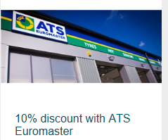





CAMbens – Discounts and Financial
TOTUM (NUS) card - £14.99 a year for use in high street shops
Local Discounts – Use your University card
Payroll Giving – donate to charity from your salary
Notes:
SAM
TOTUM card - NUS discount
As a staff member of the University of Cambridge, you are entitled to purchase a TOTUM card (previously NUS) for £14.99, for use at thousands of high street, online stores, eateries, subscriptions and various other channels.
Local Discounts
University supports local retailers and has worked together with many of them to provide employees with special deals and discounts. These include: gyms, punting, local restaurants, clothing and are available by showing your University card in-store.
The shopping discounts section on the CAMbens website includes all of the details and we keep adding to them, so its worth checking back regularly.
Payroll Giving
Payroll Giving is a simple, tax-efficient way for employees to make monthly donations to any UK registered charity directly from their gross pay.

Slide 41

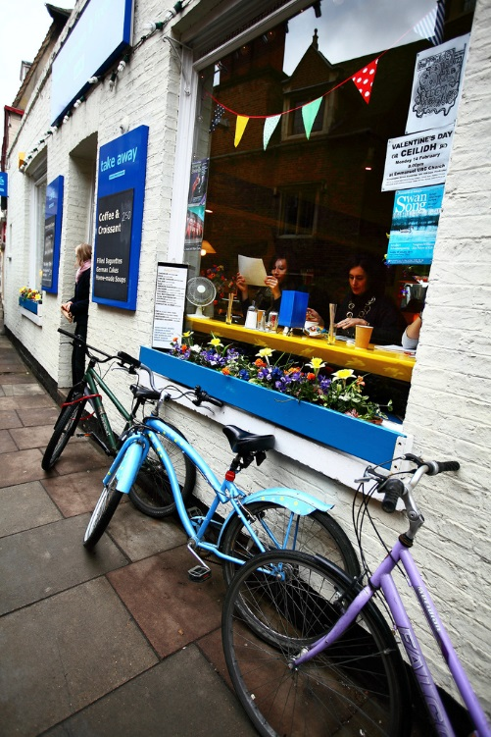
CAMbens – Relocation and Housing
  Accommodation service
  https://www.accommodation.cam.ac.uk/
  Relocation expenses
  Eddington community
  Newcomers and visiting scholars
  Local discounts with removal businesses
  Rental deposit loan
Notes:
BEV
Accommodation Service
Help all members of Cambridge University to find suitable accommodation.
Relocation expenses
If you are new to the University and relocating to Cambridge on a centrally funded appointment of two years or more.
Eddington Community
at the North West Cambridge Development. Home available to rent and later to buy, enquire through the accommodation service.
Newcomers and Visiting Scholars
Volunteers run group who aim to help newly arrived wives, husbands, partners and families of Visiting Scholars and Senior Members of the University to settle down in Cambridge and give them an opportunity to meet local people.
Rental deposit loan
Great attraction and retention tool to help staff in the difficult Cambridge rental market.

Slide 42

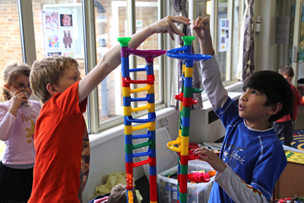

CAMbens – Family Friendly
  My family care (elder and childcare)
  Flexible working policy
  Family leave policies
  Childcare support
  https://www.childcare.admin.cam.ac.uk
Notes:
SAM
First of these is My Family Care who deliver family-friendly backup care and will give employees access to a network of child, adult and eldercare across the country at short notice. Introduced by the Equality and Diversity team,
Flexible working policy and the support give to staff who have family commitments
And along side this the University has a range of family policies that go well beyond the legal requirements. Prime example of this being the shared parental leave policy, which gives partners up to 18 weeks at full pay when sharing maternity/ adoption leave with the other parent. And while you cant exactly ask this at an interview, ensuring staff and candidates know what the University offers all forms part the picture to make us an employer of choice.
Childcare support including university nurseries (salary sacrifice the whole cost of these). CCVs available to existing members, TFC available for everyone else. Holiday clubs and info services for university parents.

Slide 43


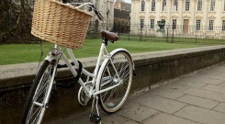


CAMbens - Travel
Cycle to Work Scheme – Salary sacrifice bike scheme which enables savings of up to 42% on a bike. Spreads the cost of the bike over 10 months.
Travel to work loan – Interest free loan to help spread the cost of annual bus or rail season ticket or the purchase of a bike
Train discount - 10% discount rate on the purchase of train season tickets and bulk-buy tickets on certain routes.
Universal bus discount – Discounted rate of £1 per journey when you show your University card.
Notes:
BEV
Next up, travel – however you get around
Cycle to work scheme is probably one of our most widely recognized schemes – over 2200 certificates have been issued. See requests on average daily for new certificates.
The scheme enables eligible staff to borrow up to £2000 to purchase a new bike and related safety equipment and receive tax and NI savings (so between about 32 and 42% saving on the cost)
Alongside this we operate a travel to work loan (so while no direct saving it does allow for a big upfront costs to be spread out over the year
Those who travel by train can access season ticket discounts on all tickets into Cambridge (even if you coming in from London). There are detailed maps on the routes on the Environment and energy webpages.
The Universal bus £1 ticket allows for travel from Eddington to the Addenbrookes site (and it does also apply to some other Go Whippet services from the edge of town).

Slide 44

CAMbens - Wellbeing
Private Medical Insurance
Local and National gym discounts
Pensions and Savings
Staff Counselling Service
Wellbeing support
Physical Financial Mental
The University’s Wellbeing Agenda
Notes:
SAM
Wellbeing can be defined as: ‘Creating an environment that promotes a state of contentment which allows an employee to flourish and achieve their full potential for the benefit of themselves and their organisation’ We consider there to be three pillars of wellbeing, Physical, Financial and Mental.
Physical – PMI at discounted rates, and discounts at local and national gyms. Also have Occupational Health and Westfield Health which offers a scheme where individuals pay a small monthly amount and can then claim back the cost of routine health costs such as dentist or opticians bills.
Mental - Staff Support Services – Staff Counselling, HR contacts, internal mediation service, dignity at work contacts, PPD, E&D, OHS, & wellbeing advocates (new).
Financial – part of this is the pension scheme offered by the University. You also have access to an exclusive CAMbens savings account through the Cambridge Building Society.

Slide 45

Reward suggestion box
Have an idea or suggestion on the way the University rewards its staff through benefits, pay or recognition?
Let us know now or email us at: CAMbens@admin.cam.ac.uk at any time
We’d love to hear any ideas you have on how we can reward people differently, all ideas will be considered by the Reward Team.
Your feedback is invaluable in helping us to shape and deliver reward and benefits that are used by University employees.
Notes:
BEV
So, that gives you a summary of the current benefits on offer, and an overview of the new scheme we are launching. We are always keen to hear any ideas for new benefits, and we have a reward suggestion box where you can send any ideas to. Please do get in touch, we’d love to hear from you. This is very important to help us shape and deliver future rewards.

Slide 46


Any Questions ?
Notes:
SAM
Thank you for listening, we’d welcome any questions.
Answer questions on their respective areas.

